Slide 1


Final Year Project
Skill Link
Supervised By:Mr Muhammad Nadeem Khan

Slide 2
Project Team
Sana Ullah 13328
Hammad Javed 26693

Slide 3
Table of Content
Opportunity & Stakeholders
Solution
Progress Report Summary
Requirements
Software System (Design + Implementation + Testing)
Endeavour (Team + Work + Way of Working)
Next Steps
Prototype / Report

Slide 4
Opportunity & Stakeholders

Slide 5
Opportunity
Hard to Find Good Workers
People often struggle to find reliable and skilled workers like plumbers or electricians. Many times, they don't know who to trust or where to look.
Takes Too Much Time
Searching for a worker, calling around, and comparing prices or availability can waste a lot of time and effort for both customers and workers.
Help Needed in Emergencies
In urgent situations like a gas leak or electrical problem, people need quick help but don’t have a fast way to contact nearby professionals.

Slide 6
Stakeholders
Customers
Workers(Plumber,Electrician,Cleaner)
Admin

Slide 7
Solution
SkillLink is a mobile app that helps people quickly find trusted skilled workers like plumbers, electricians, and house cleaners.
The app uses real-time location to show nearby workers, so you can get help fast.
You can check worker profiles book services in this mobile application.
Prices are clear and fair, with no hidden charges.
SkillLink helps you find the right person for the job, even in an emergency.

Slide 8
PROGRESS REPORT Summary

Slide 9
Requirements
Elicitation Techniques / Tools
Observation:
Brainstorming:
Functional Requirements
Customer
Worker(Plumber,Electrician,Cleaner)
Admin
Non-Functional Requirements:
None
Use Cases

Slide 10
Design
Model View Controller Diagram
Use-Case Diagram
Class Diagram
Activity Diagrams
Development Diagram

Slide 11
Implementation
List Development Tools & Technologies
Tools | Technologies
• Visual Studio Code • Andorid Studio • Visual Paradigm • Git & GitHub • XAMPP • Canva | • Flutter • Dart • Laravel • My SQL

Slide 12
Implementation
List Best Practices / Coding Standards
1. Software Engineering Methodologies
Agile Methodology
Scrum Framework
2. Coding Standards
Naming Conventions
Code Documentation

Slide 13
Endeavour

Slide 14
Endeavour
Describe roles of your team members
Team Members
Sana Ullah
Hammad Javed

Slide 15
Endeavour
Roles:
Both team members worked together on all parts of the project, including plaining, documentation, design and implementation .
Describe your software development process
Requirement Gathering: Identified functional and non-functional requirements using elicitation techniques

Slide 16
Work Breakdown Structure (List of all Deliverables / Strikethrough Completed Deliverables)
1. Project Managment
Define Scope
GitHub Repositories
2. FYP Report
Project Scope & Objective
Functional Requirments
3. Designs
Model View Controler Diagram
Class Diagram
Activity Diagram
Use case Diagram
Development Diagram
4. Modules
Booking
Plumber Booking
Electrician Boooking
Cleaner Booking
Real Time Location
Ratings & Reviews
Emergency Services
In-App Chat

Slide 17
Prototype & Report

Slide 18
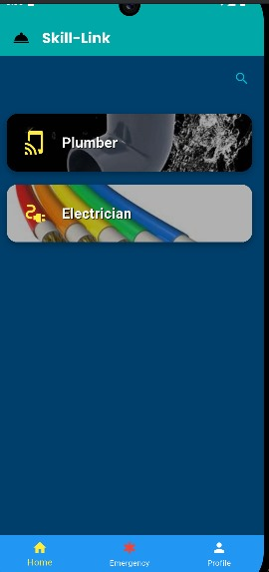
Prototype

Slide 19
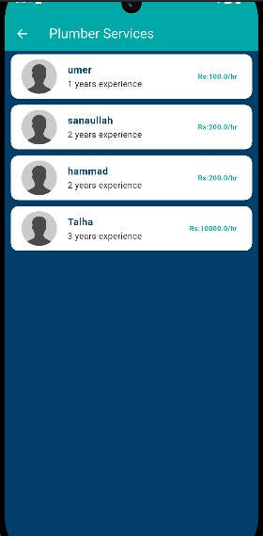
Prototype

Slide 20
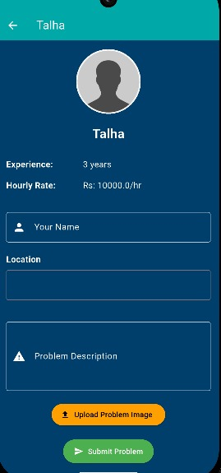
Prototype

Slide 21
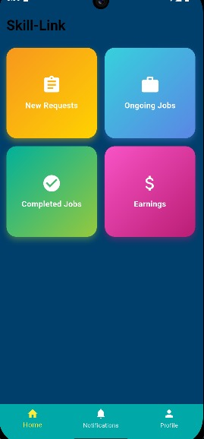
Prototype

Slide 22
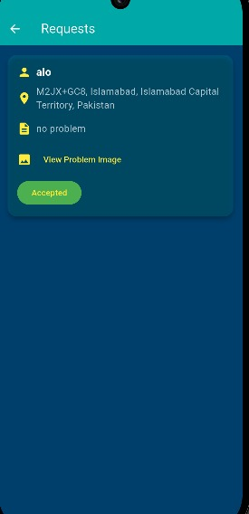
Prototype

Slide 23
Report
Chapter 1: Introduction
Chapter 2: Literature / Market Survey
Chapter 3: Requirement Analysis
Chapter 4: System Design
Chapter 5: Implementation
Chapter 6: Testing & Evaluations
Chapter 7: Conclusion & Outlook

